Slide 1
REDUX

Slide 2
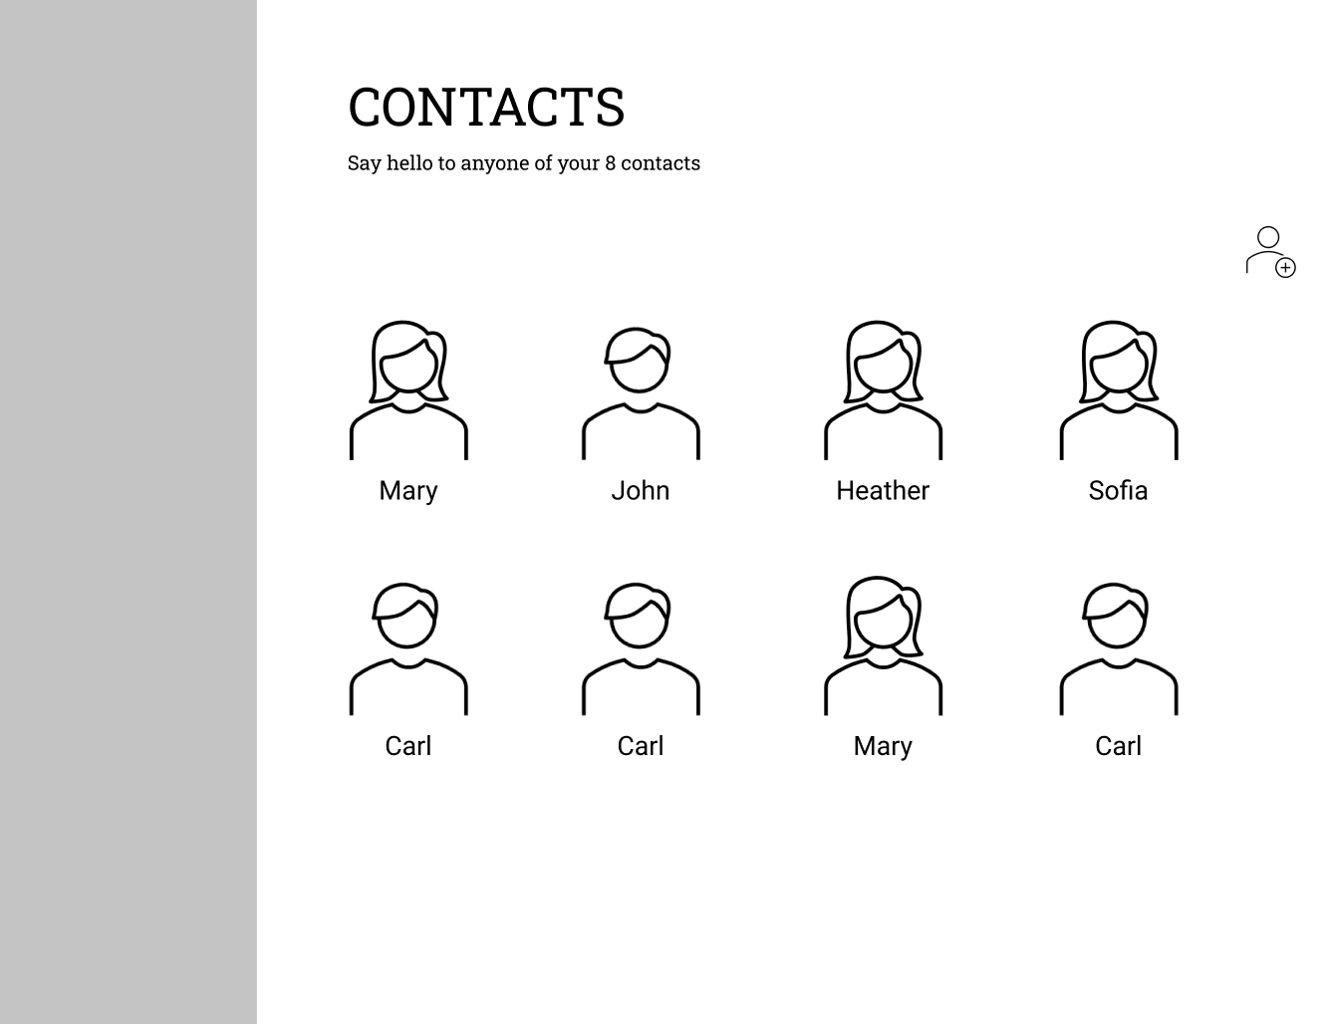

Slide 3
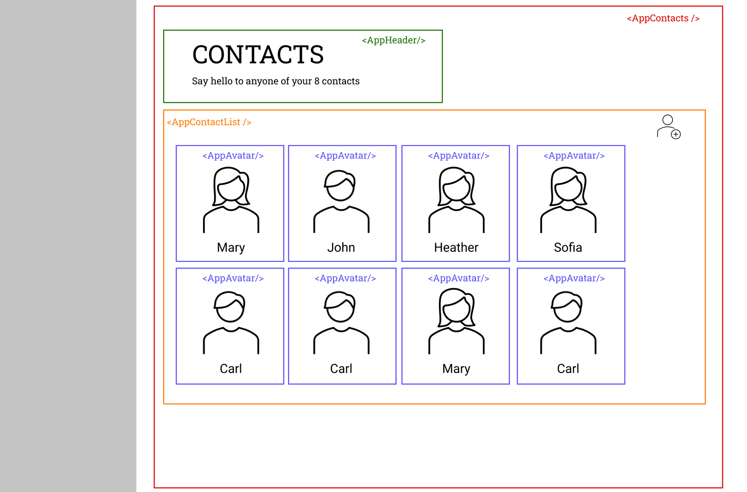

Slide 4
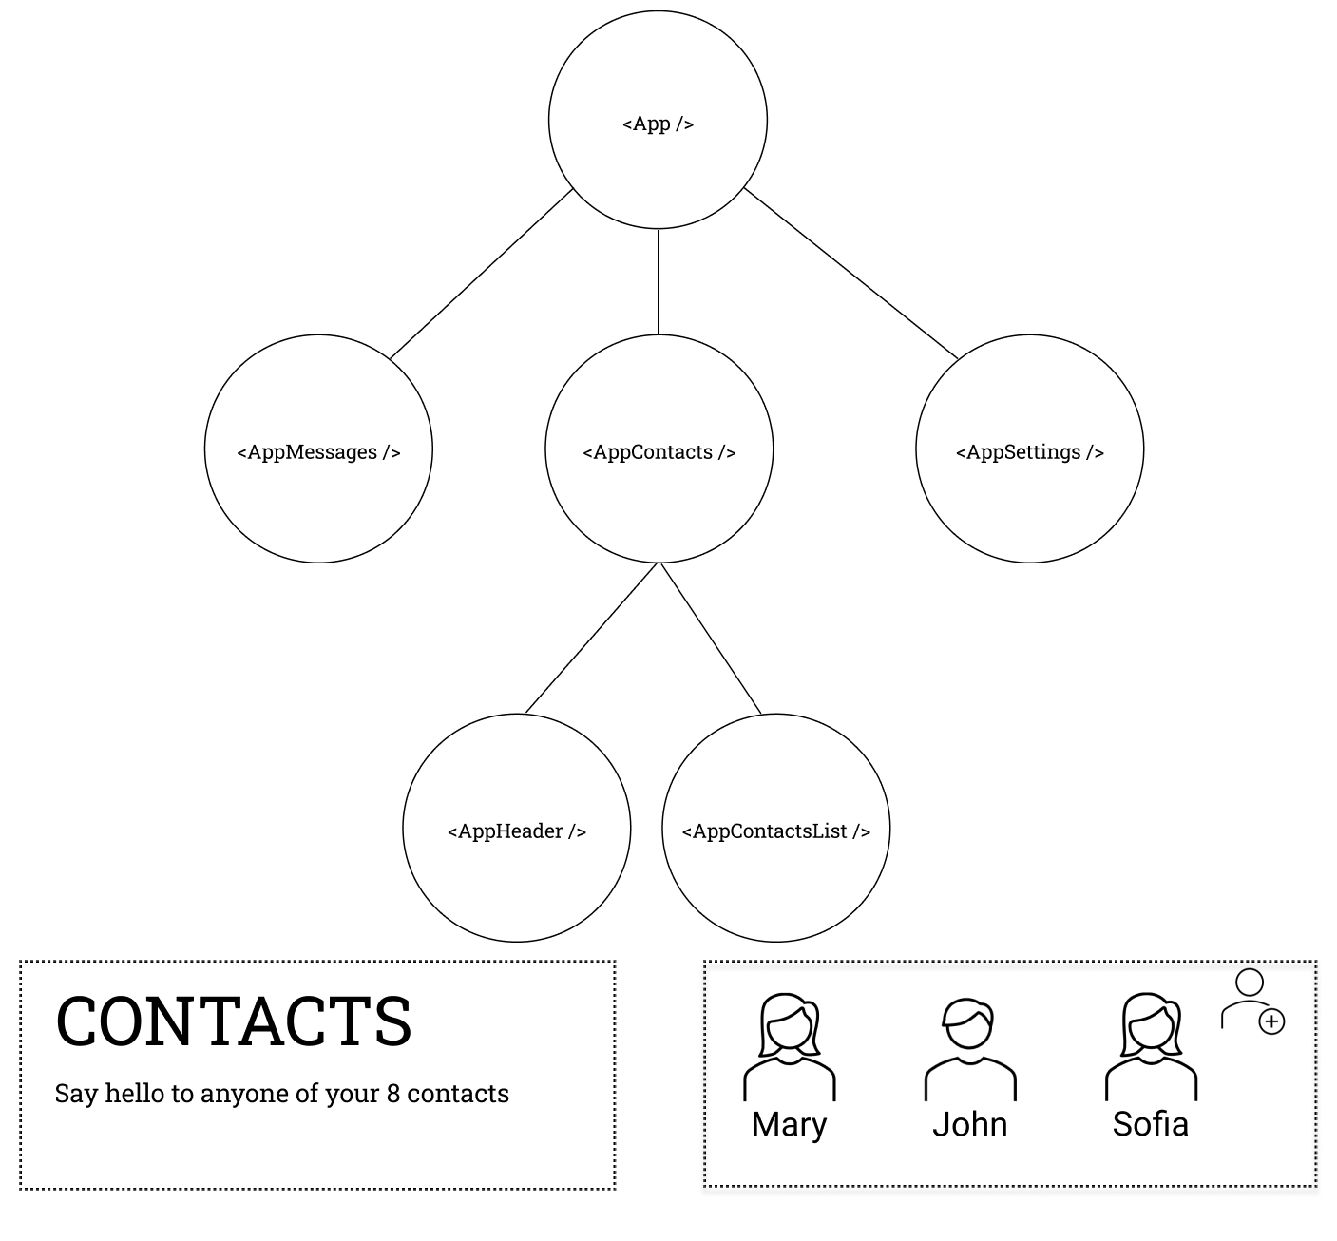

Slide 5
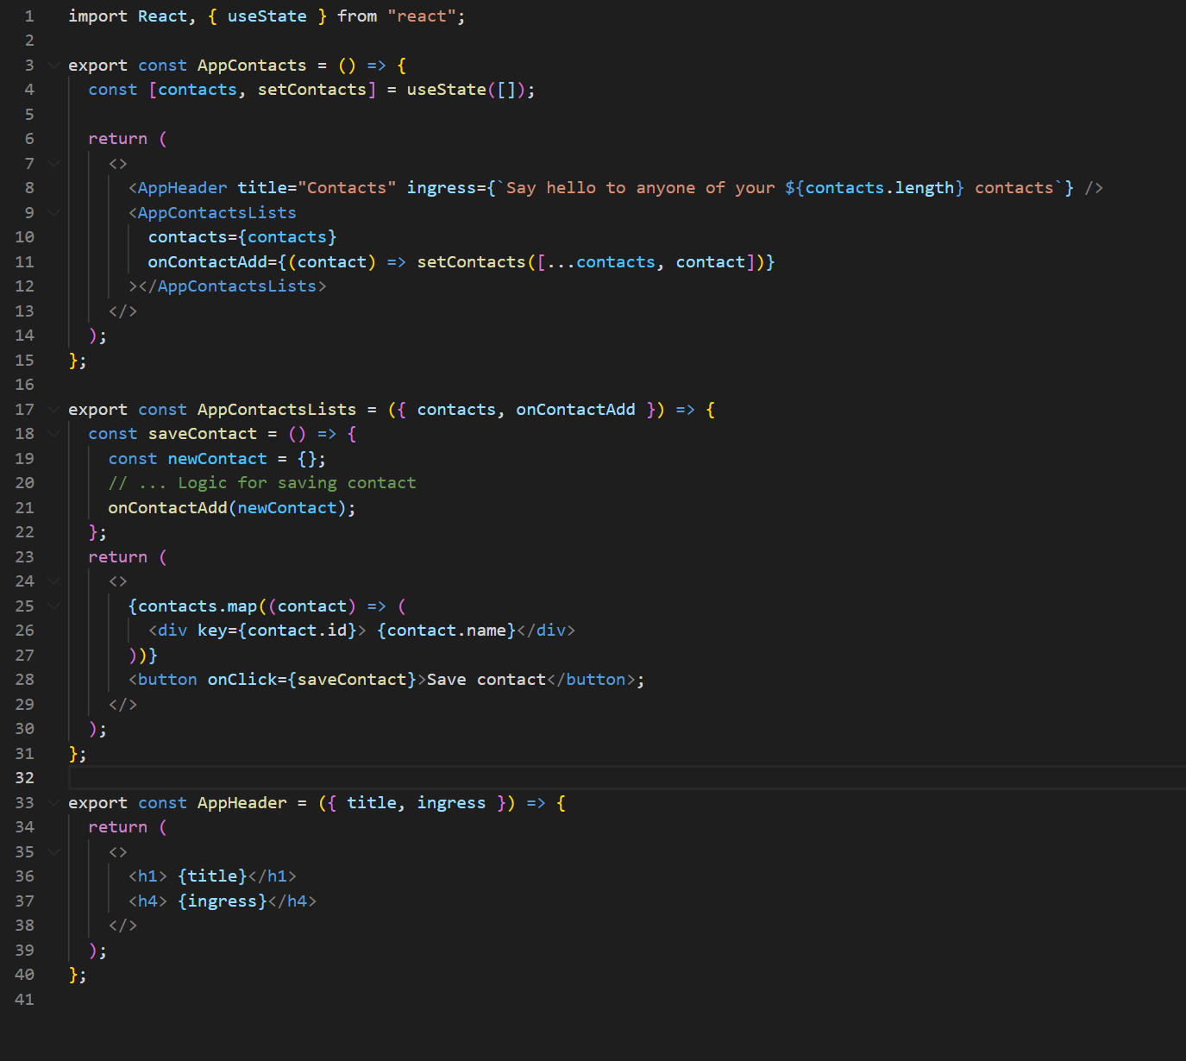

Slide 6


Slide 7
Actions
State
View
Notes:
How does React handle updates/re-renders It is a self-contained app with the following parts:
The state, the source of truth that drives our app;
The view, a declarative description of the UI based on the current state
The actions, the events that occur in the app based on user input, and trigger updates in the state
One way data flow
State describes the condition of the app at a specific point in time
The UI is rendered based on that state
When something happens (such as a user clicking a button), the state is updated based on what occurred
The UI re-renders based on the new state

Slide 8
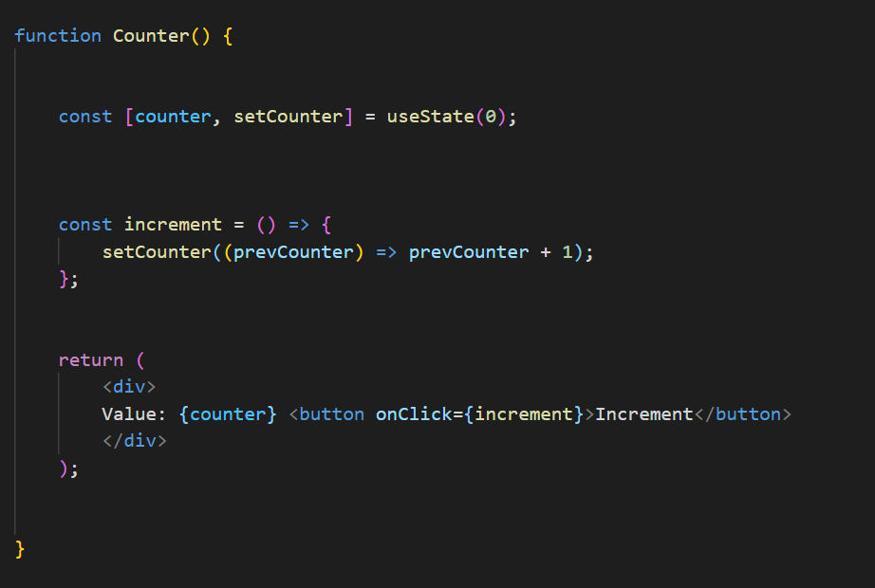
State
Action
View

Slide 9
Overview
Global state is stored in an object tree within a single store.
Only way to change the state tree is through actions.
Actions are objects describing what happened.
Actions must be dispatched to the store.
Reducer functions handles the actions and updates the state.
Only reducers can update data in the store, which ensures that state is only updated in a predictable fashion.

Slide 10
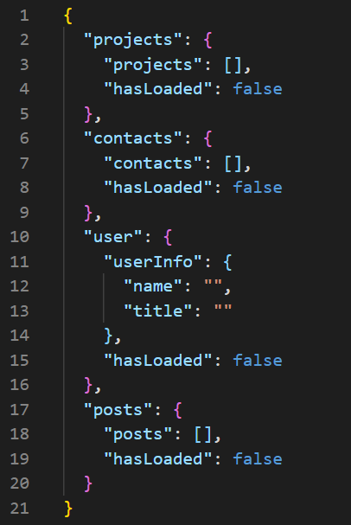
STORE
ACTIONS
DISPATCH
REDUCERS
Notes:
Simple JSON tree structure

Slide 11
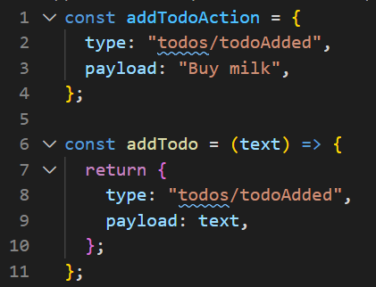
STORE
ACTIONS
DISPATCH
REDUCERS
Notes:
An action is a plain JavaScript object that has a type field and optionally a payload. An actions describes something that happened in the application.
Normally type is written as “domain/eventName”, where domain points to the feature or category and eventName the events that happened.
On on th eimage we see both an action and action creator. Action creators makes sure that you do not have to write the type every time.

Slide 12
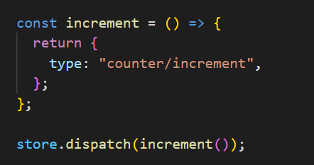
STORE
ACTIONS
DISPATCH
REDUCERS

Slide 13
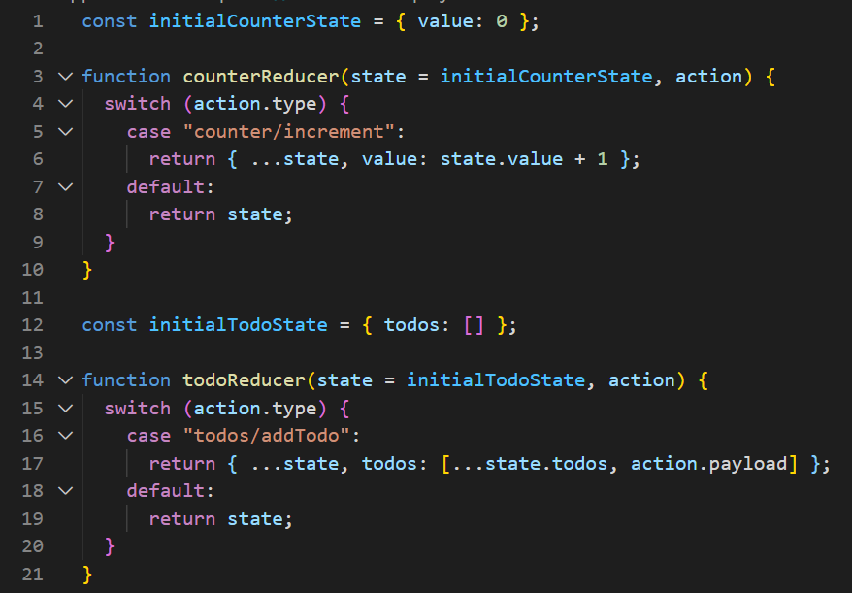
STORE
ACTIONS
DISPATCH
REDUCERS
Notes:
A reducer is a function that receives the current state and an action object, decides how to update the state if necessary, and returns the new state: (state, action) => newState. You can think of a reducer as an event listener which handles events based on the received action (event) type. Reducers must always follow some specific rules:
They should only calculate the new state value based on the state and action arguments
They are not allowed to modify the existing state. Instead, they must make immutable updates, by copying the existing state and making changes to the copied values.
They must not do any asynchronous logic, calculate random values, or cause other "side effects"
The logic inside reducer functions typically follows the same series of steps:
Check to see if the reducer cares about this action
If so, make a copy of the state, update the copy with new values, and return it
Otherwise, return the existing state unchanged

Slide 14
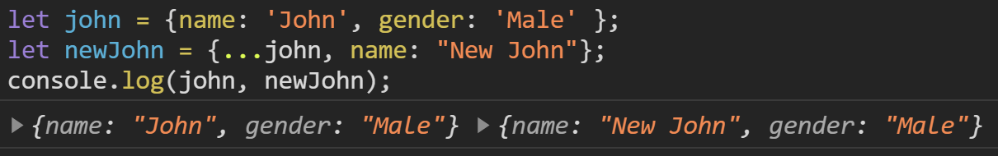
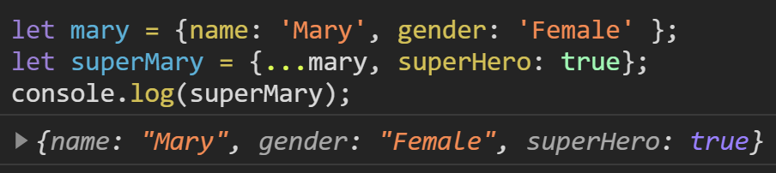
STORE
ACTIONS
DISPATCH
REDUCERS
Notes:
A reducer is a function that receives the current state and an action object, decides how to update the state if necessary, and returns the new state: (state, action) => newState. You can think of a reducer as an event listener which handles events based on the received action (event) type. Reducers must always follow some specific rules:
They should only calculate the new state value based on the state and action arguments
They are not allowed to modify the existing state. Instead, they must make immutable updates, by copying the existing state and making changes to the copied values.
They must not do any asynchronous logic, calculate random values, or cause other "side effects"

Slide 15
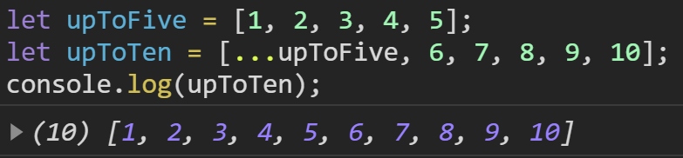
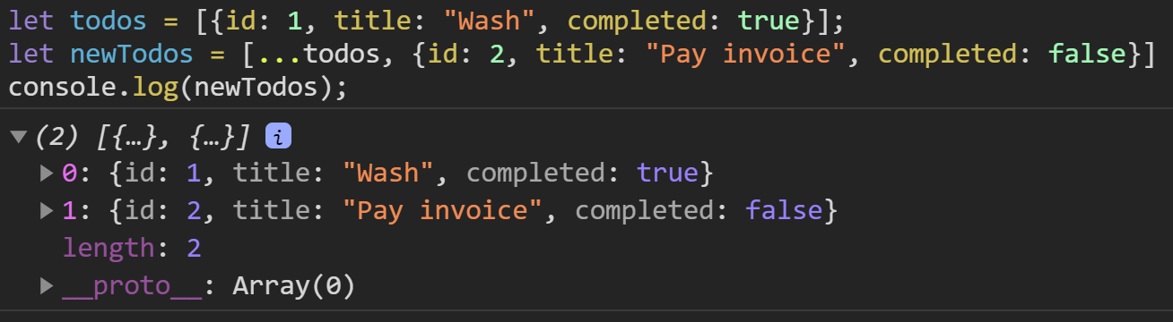
STORE
ACTIONS
DISPATCH
REDUCERS

Slide 16
STORE
ACTIONS
DISPATCH
REDUCERS

Slide 17
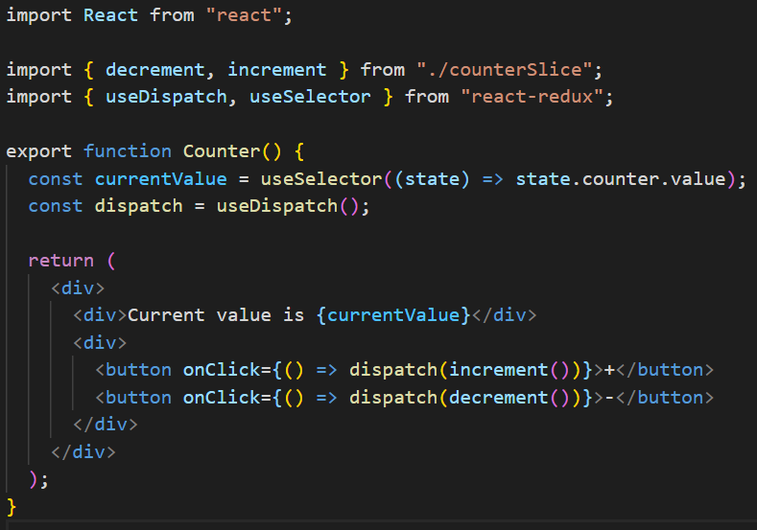
Notes:
Each component can use useSelector to subscribe to values

Slide 18
Actions
State
View
Notes:
How does React handle updates/re-renders It is a self-contained app with the following parts:
The state, the source of truth that drives our app;
The view, a declarative description of the UI based on the current state
The actions, the events that occur in the app based on user input, and trigger updates in the state
One way data flow
State describes the condition of the app at a specific point in time
The UI is rendered based on that state
When something happens (such as a user clicking a button), the state is updated based on what occurred
The UI re-renders based on the new state

Slide 19
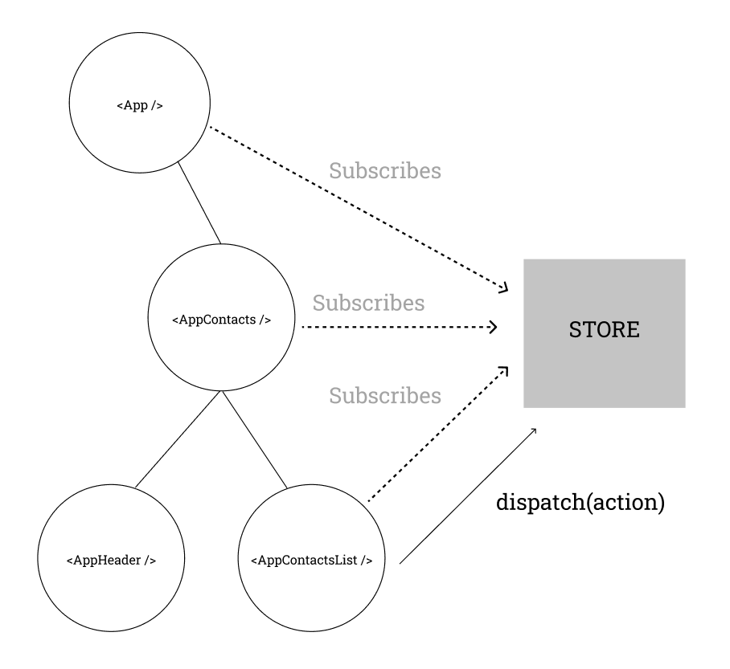
Notes:
Something happens in the app, such as a user clicking a button
The app code dispatches an action to the Redux store, like dispatch({type: 'counter/increment'})
The store runs the reducer function again with the previous state and the current action, and saves the return value as the new state
The store notifies all parts of the UI that are subscribed that the store has been updated
Each UI component that needs data from the store checks to see if the parts of the state they need have changed.
Each component that sees its data has changed forces a re-render with the new data, so it can update what's shown on the screen

Slide 20
When to use
You have reasonable amounts of data changing over time
You need a single source of truth for your state
You find that keeping all your state in a top-level component is no longer sufficient

Slide 21
Should all data be in the store?

Slide 22
Source: https://redux.js.org/tutorials/essentials/part-1-overview-concepts

Slide 23
Provider

Slide 24
CODE

